Slide 1
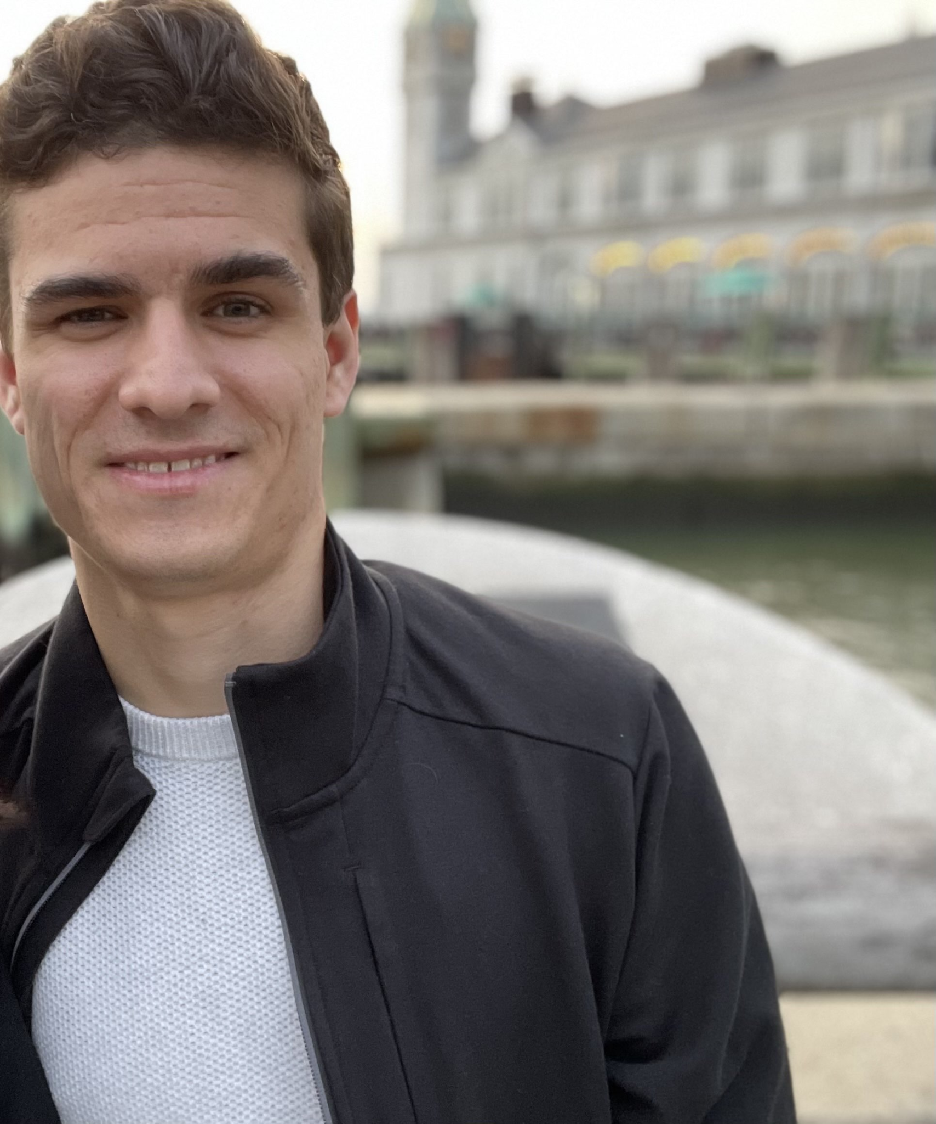




Sensor Network
Final Presentation
Ian Wallace
Computer Engineering
Parke Benjamin
Electrical Engineering
Paul Wood
Computer Engineering
Randy Alvarez
Electrical Engineering
Notes:
Paul

Slide 2
Project Motivation
Provide a device that will assist those sensitive to negative changes in outdoor air quality
Provide a solution that is cheaper than existing alternatives
Create a device that estimates outdoor air quality.
Notes:
Paul

Slide 3
Project Goals
Design a device that can detect air pollutants in the surrounding area
Estimate the EPA’s air quality index (AQI)
Wirelessly send the data using a long distance, low power communication protocol
Operate off of both solar power and battery
Collected data will be displayed on a website
Notes:
Ian

Slide 4
Project Objective
Low cost and lightweight
Require little to no maintenance
Easy to install
Communicate sensor data over a LoRaWAN network
Display collected sensor data on a web application
Notes:
Ian

Slide 5
Project Requirements
No. | Requirement | Unit
1 | The device shall calculate the AQI with in a specified percentage of the EPA’s reported value. | ±25%
2 | The device shall have an average power draw of less than the specified number of watts | 100 mW
3 | The device shall be able to automatically take a sensor reading from each sensor at a specified time interval | 15 minutes
4 | The battery can be fully charged through a USB connection at 500 mA in 6 hours | 6 hours
5 | The solar panel maintains the battery at 80% capacity or more during normal operation | 80 %
6 | The device shall have an average current draw off less than 5 mA while operating in sleep mode | 5 mA
7 | The device shall have an average current draw off less than 250 mA during normal operation | 250 mA

Slide 6
Project Constraints
Time was a major constraint (only ~6 months)
Money was a constraint
Managing complexity

Slide 7
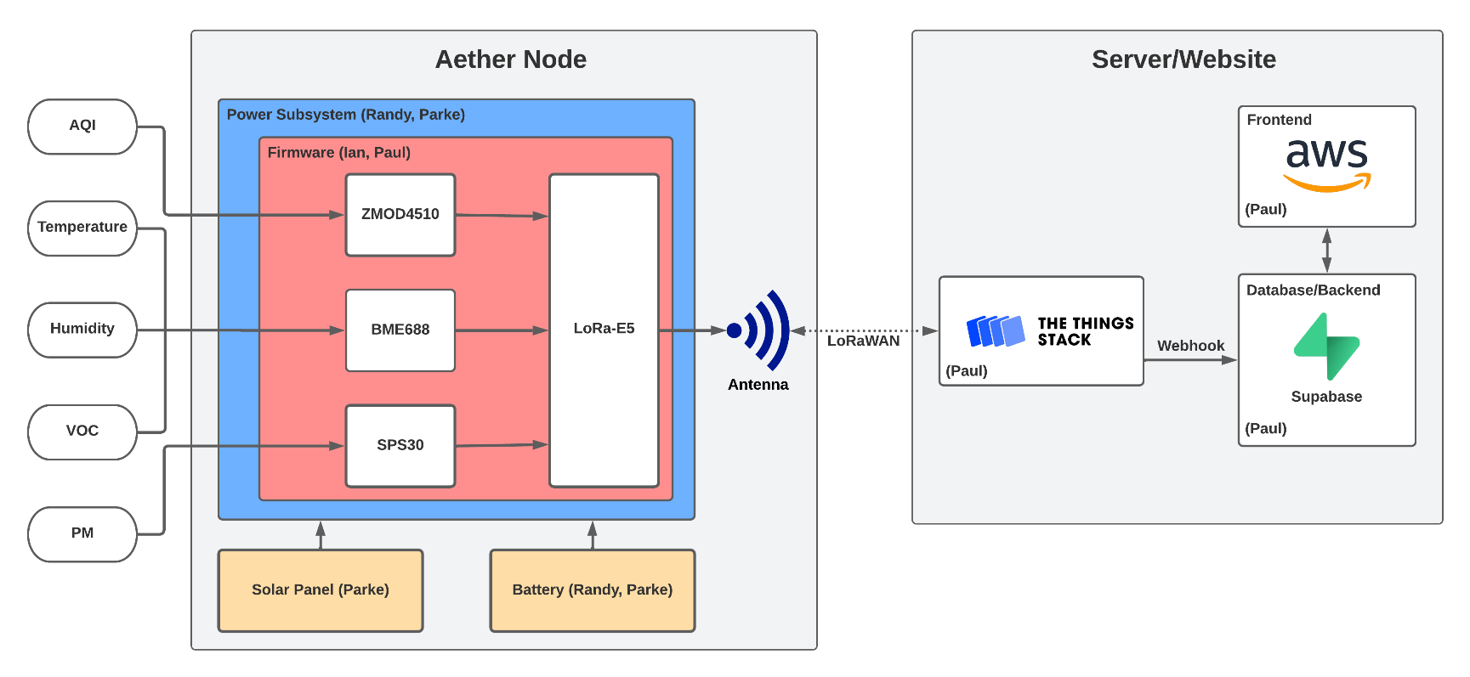
Overall Block Diagram
Notes:
Paul

Slide 8
Hardware and Power

Slide 9
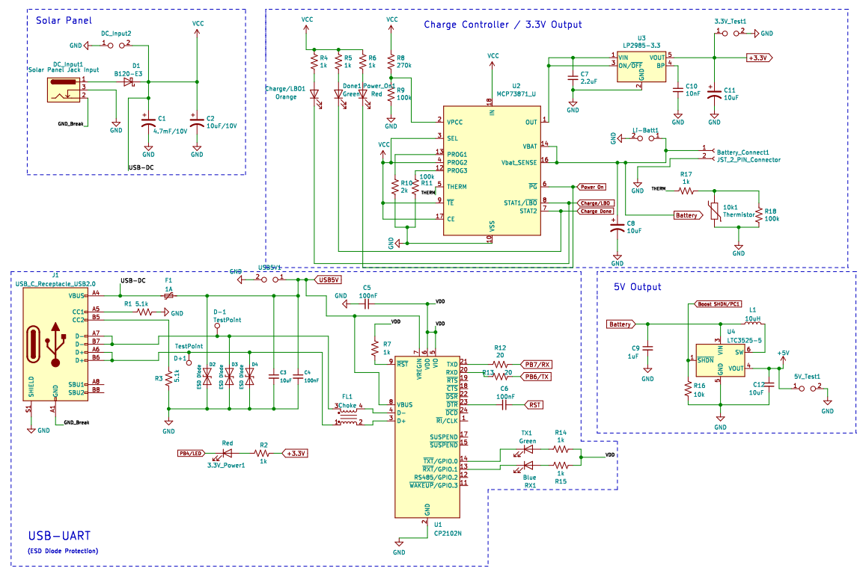
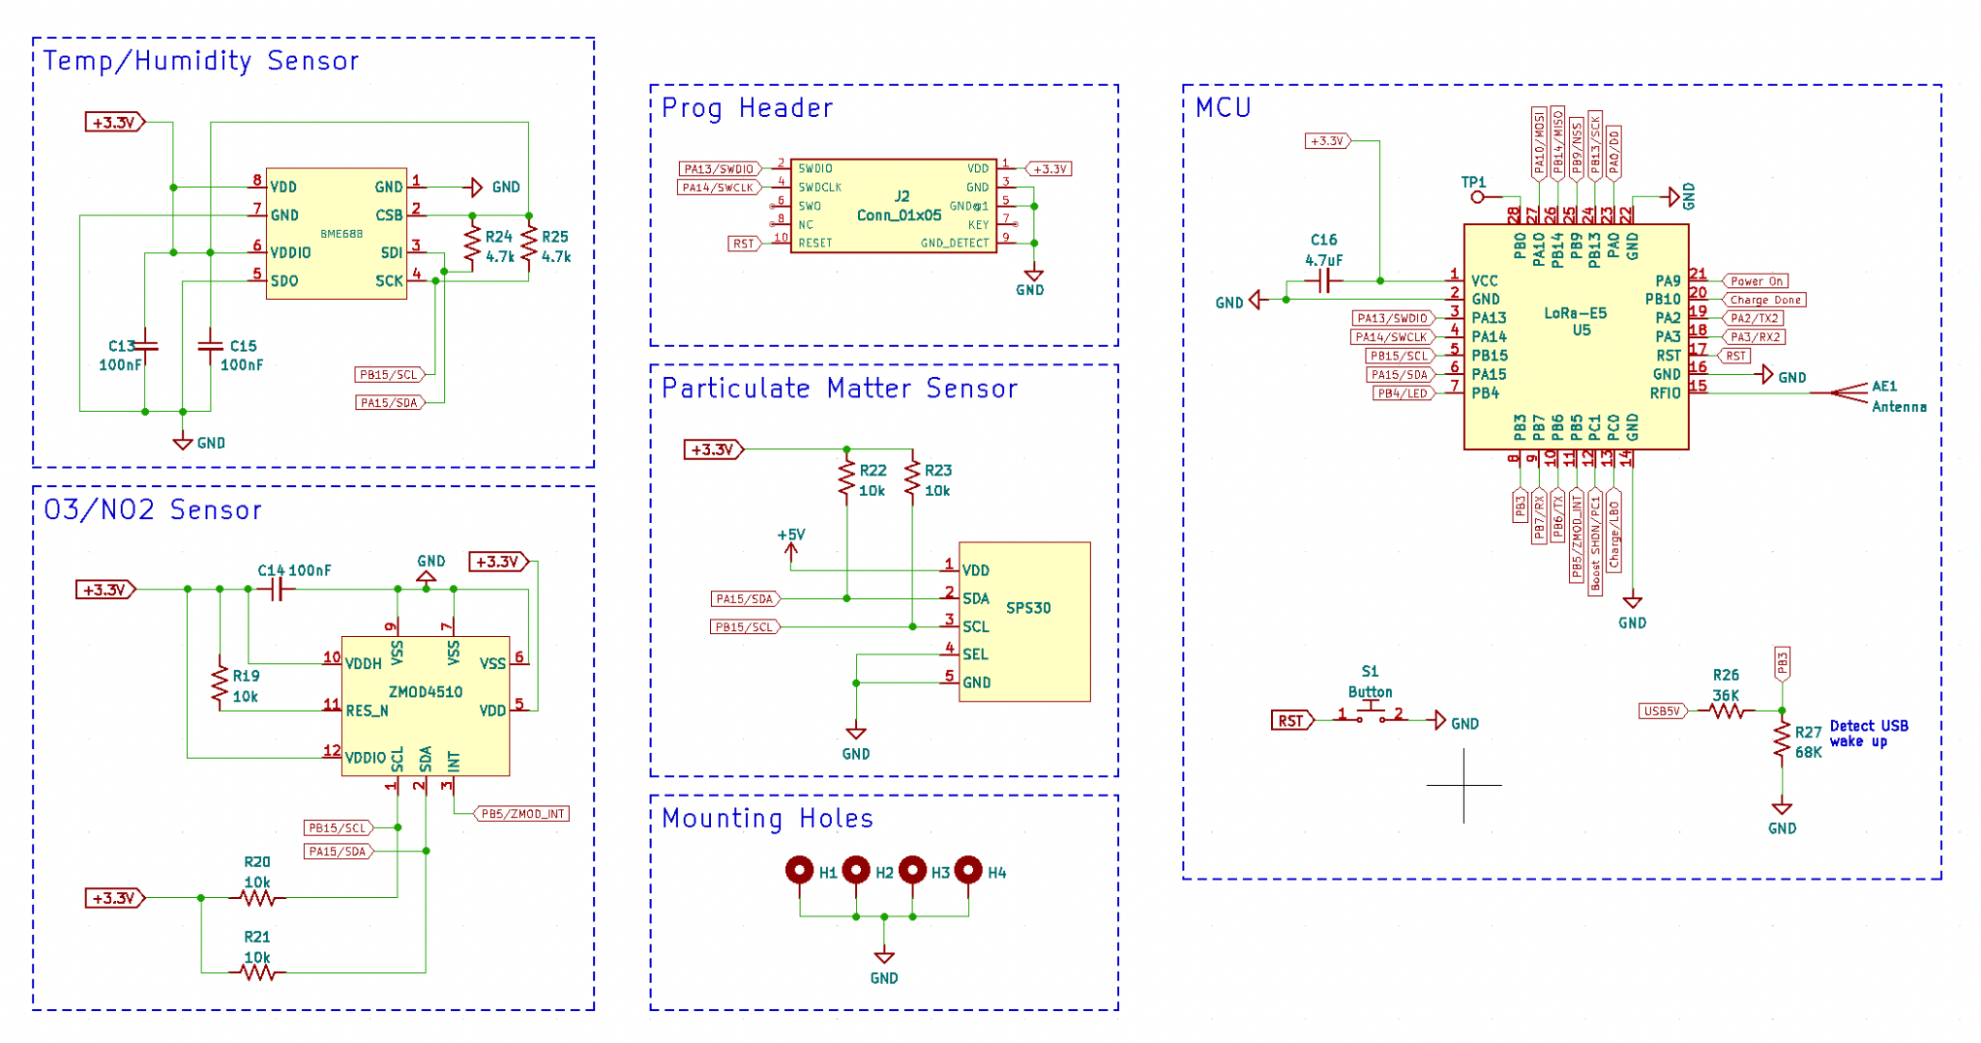
Overall Schematic
Notes:
The overall schematic can be seen in this slide. From left to right you can see the solar panel and USB-C power inputs connecting to the charge controller with the USB-C circuit also interfacing with a USB-to UART IC. On the right side we see the 3 sensor connecting to the LoRa MCU in addition to the SWD programming header.

Slide 10
Power Usage (Original Calculation)
Part | Input Voltage High (V) | Max Current (mA) | Max On Power Usage (mW) | Sleep Current (uA) | Max Sleep Power Usage (uW)
PM Sensor | 5.5 | 65 | 357 | 0 | 0
Renesas AQI Sensor | 3.6 | 13 | 46.8 | 0.45 | 1.62
Bosch Sensor | 3.6 | 15 | 54 | 1 | 3.6
Seed LoRa-E5 | 3.6 | 150 | 540 | 2 | 7.2
Other Losses | 3.3 | 1 | 3.3 | 15 | 49.5
Approximately 2 month battery life
Notes:
The max current used would come out to 244A while the device was in use. However during sleep mode the device would use approximately 18.45uA. This leads us to calculate that with a 2Ah battery while taking measurements every hour our system could survive 2 months on a fully battery charge.

Slide 11
Power Usage Without Solar (Actual Measurements)
Measurement Parameter | Value
ZMOD4510 Sampling Period | 15 minutes
ZMOD4510 Sampling Rate | 1.98s
ZMOD4510 On-Time | 30 seconds
SPS30 Sampling Period | 15 minutes
SPS30 Sampling Rate | 5 seconds
SPS30 On-Time | 3 minutes
BME688 Sampling Period | 15 minutes
BME688 Sampling Rate | 1 second
BME688 On-Time | 5 seconds
LoRaWAN Data Rate | 11 - 250 bytes
Parameter | Value
Avg. Battery Voltage (V) | 3.93
Min. Current (mA) | 0.832
Max. Current (mA) | 197
Avg. Current (mA) | 18.7
Avg. Power (mW) | 73.4
Approximately 4.46 days battery life
Notes:
When it comes to actual power usage we must use a series of measurements to capture the moments when the device is in use over an extended period of time to get a better grasp of the real power requirements. This way we can see how well our calculations measure up to the real power consumption. Here you can see the average battery voltage, the range of current and its average, as well as the average power consumed. From this we can calculate that the battery could support the system over a period of x months without aid of the solar panel.

Slide 12
Net Power Usage With Solar (Actual Measurements)
Measurement Parameter | Value
ZMOD4510 Sampling Period | 15 minutes
ZMOD4510 Sampling Rate | 1.98s
ZMOD4510 On-Time | 30 seconds
SPS30 Sampling Period | 15 minutes
SPS30 Sampling Rate | 5 seconds
SPS30 On-Time | 3 minutes
BME688 Sampling Period | 15 minutes
BME688 Sampling Rate | 1 second
BME688 On-Time | 5 seconds
LoRaWAN Data Rate | 11 - 250 bytes
Measurement Parameter | Value
Avg. Battery Voltage (V) | 4.00
Avg. Panel Voltage (V) | 6.12
Net Current Consumption (mA) | -183
Net Power Consumption (mW) | -730

Slide 13
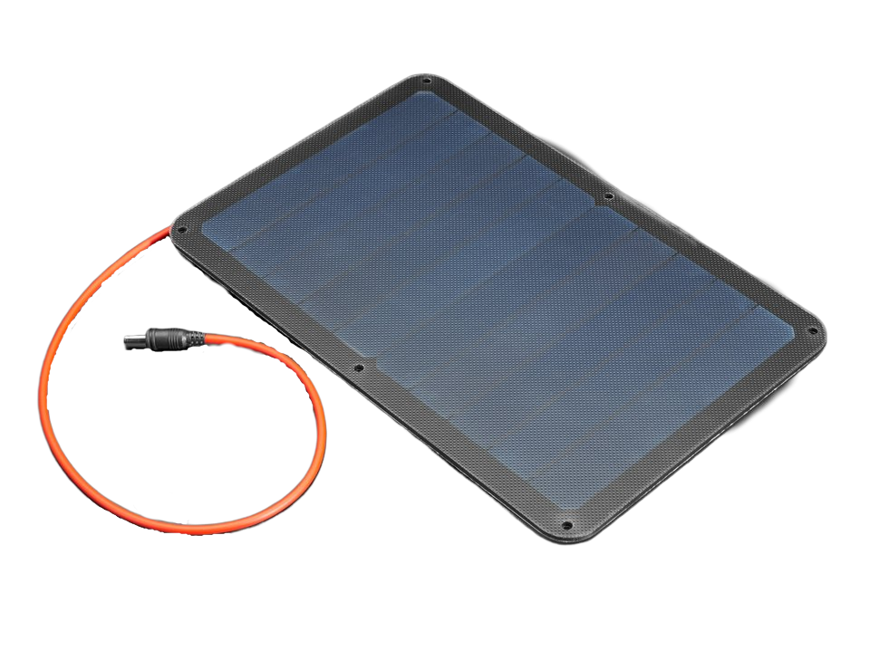
Solar Panel
Selected Component: Voltaic Systems P105
Constructed with ETFE (Ethylene Tetrafluoroethylene)
Open Circuit Voltage: 7.13V
 | Voltaic Systems P105 | Voltaic Systems 3.5W 6V
Panel Type | Monocrystalline | Monocrystalline
Dimensions | 8.74” L x 5.394” W x 0.157” D | 8.3" L x 4.4" W x 0.2" H
Unit Cost (USD) | 35.00 | 45.00
Max Power (W) | 5.75 | 3.69
Ip/Isc (mA) | 940/990 | 550/590
Vp/Vsc (V) | 6.12/7.13 | 6.7/7.7
Notes:
When it came to the solar panel we wanted 3 things high efficiency, small size, and low cost. When it comes to the selection we had the specifications were few. First the range of the solar panels input voltage had to be roughly 6V for the charge controller. Second we needed a solar panel roughly the size of the unit (9”X5”). From here our options were narrowed down until we found the two units shown. The P105 was chosen due to a lower cost, its input voltage more closely aligned with the charge controller, and its higher current supply that would provide more power to the unit.

Slide 14
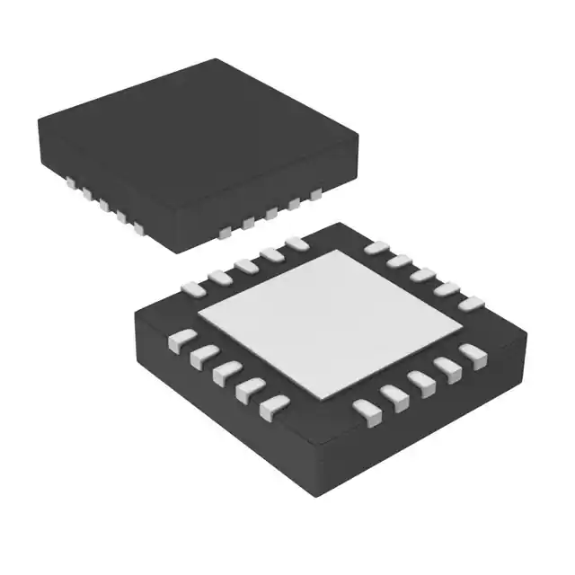
Solar Panel Charge Controller
Selected Component: MCP73871
Integrated System Load Sharing and Battery Charge Management
Simultaneously Power the System and Charge the Li-Ion Battery
 | BQ2416xx | MCP73871
IN Operating Voltage Range (V) | 4.2 - 18 | 0.3 - 6
Iss Max Charge Range (mA) | 0 - 2.5 | 2.50 - 3.75
Unit Cost (USD) | 3.00 | 3.00
Leakage Current (uA) | 5 | 1
Fast Charge Rate (mA) | 550 - 2500 | 100 - 500
Charge Voltage Range (V) | 6.12/7.13 | 6.7/7.7
Notes:
When its came to charge controllers we had a few requirements that any chosen charge controller had to fulfill. First the controller must accept duel-power input lines to accept power from both a USB connection of a solar panel. Second the chargers must have built in circuit protections and timers to ensure the battery would not be charged under hazardous conditions. Finally the chargers must be capable of powering a load while charging the battery at the same time. When it came down to selecting the charger between the selection we had remaining the MCP stood out for several reasons. First its capability of functioning with as little as 0.3V made it a prime candidate as it would still operate even in less than prime conditions. Second its fast charge rate supplied a range of current that better matched our power requirements. Finally its lower leakage current was the final reason we determined this to be the best selection for our nodes.

Slide 15
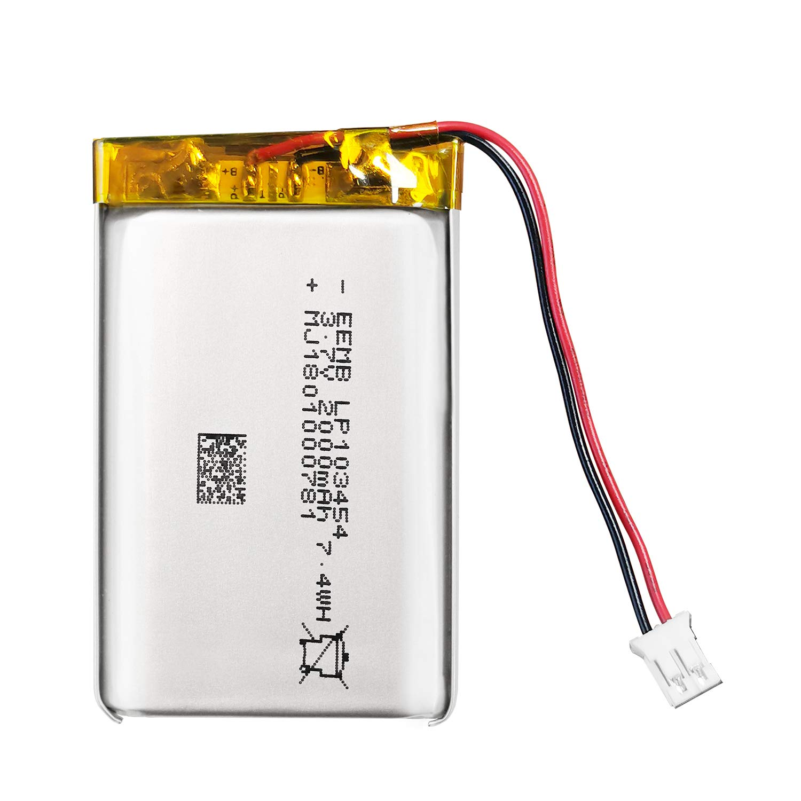
Battery
Selected Component: LP103454
Compatible with MCP73871 charging capabilities
Low cost and compact size capable of meeting system load requirements
 | PS-445 | LP103454
Chemistry | Lead Acid | Lithium Ion
Amp Hours | 4.5 | 2
Unit Cost (USD) | 20.44 | 16.99
Size(mm) | 48x53x98 | 34.5X56X11
Voltage(V) | 4 | 3.7
Notes:
When it can to battery selection the first decision we had to make was battery chemistry. Our group decided to go with lithium ion to have a more steady voltage and current as the battery discharged, a higher energy density, and a longer service life. Once we’ve determined the desired battery chemistry our decision came down to voltage, capacity, and cost. For its cost our battery provides great capacity in the size range we desired with the desired battery voltage. As a result the LP103454 was selected.

Slide 16
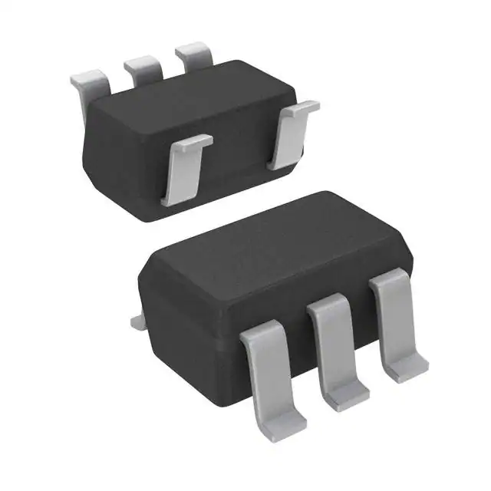
Linear Dropout Regulator
Selected Component: LP2985-3.3
Provides greater flexibility on voltage parameters
Lower cost
 | TSP78533 | LP2985-3.3
Max Input Voltage (V) | 6 | 16
Min Input Voltage (V) | 1.7 | 2.5
Output Voltage (V) | 3.3 | 3.3
Unit Cost (USD) | 1.85 | 0.89
Output Amperage (A) | 1 | 0.15
Notes:
For the linear dropout regulator the first thing we needed was a part that fulfilled our design constraints. The first constraint was an output of 3.3V to match our components, namely two sensors and the Lora. Next the output amperage must match the power requirements of about 150mA. Finally the input voltage range must match the 4.25V that the MCP would be outputting. From here our selection came down lastly to cost and availability. The LP2985-3.3 fullfills all of our requirements while being available for the lowest cost making it the best choice for our project.

Slide 17
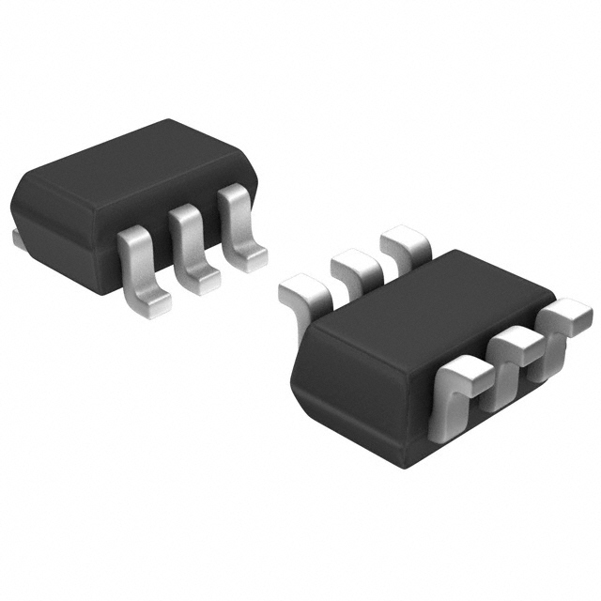
Boost Converter
Selected Component: LTC3525-5
Equipped with shutdown pin to remotely activate a low-power mode in the system
 | XC9140A | LTC3525-5
Input Voltage Minimum (V) | 0.9 | 0.85
Input Voltage Maximum (V) | 5.5 | 4.5
Output Voltage (V) | 5 | 5
Output Amperage (A) | 0.295 | 0.4
Unit Cost (USD) | 1.13 | 5.37
Ability to Shutdown | No | Yes
Notes:
Finally we needed a components capable to taking the output from the MCP components and turn it into 5V in order to completely supply our SPS-30 particulate matter sensor. Like with the linear power regulator the top priority requirements are a correct output voltage, correct input voltage range, correct output current. However from there rather than just choosing based on price and availability a design choice has skewed our priorities at this point. It was noticed that the power drawn to the SPS30, even during sleep mode was unusually high so as a result we wanted to find a boost converter with a shutdown feature. This would make the SPS30 absorb no power during sleep mode saving our battery life and lowering our power requirements. As a result the LTC turned out to match all of our requirements on top of having a shutdown feature at a reasonable price making it the clear choice.

Slide 18
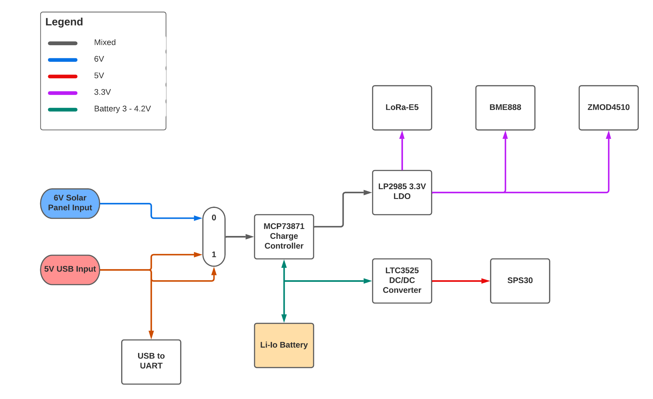
Power Subsystem Block Diagram
Notes:
In this slide we see the power subsystem block diagram. The Li-Io battery powers the system and is connected to the charge controller. To charge the battery we have 2 options; either through a USB-C 5V input or through a solar panel input, making the system fully off-grid operational. If a secondary power input is present, the charger IC uses this input to meet the system load requirements while also powering the battery. This load sharing feature maximizes the life of the battery by preventing it from constantly charging and discharging. Because solar panels can be unstable, they can cause the charger to constantly turn on and off. When the solar panel is connected, this charge controller incorporates its voltage proportional charge control feature to monitor the voltage of the solar panel while charging the battery. If the panel voltage drops below a 4.5V threshold, the charger automatically turns to the battery to power the system while allowing the panel voltage to rise again. When the USB-C input is connected, it powers the system and simultaneously charges the battery.The output of the charge controller is connected to low-voltge dropout regulator. This LDO takes the output and drops it to a constant 3.3V which will be used as the main power rail in the system.The 3.3V then powers the micro controller and the BME688 and ZMOD4510 sensors. The battery is directly connected to a 5V Boost converter with a shutdown pin, this Boost converter powers the PM sensor that operates at 5V and can be shutdown by the microcontroller to activate a low power mode.

Slide 19
Power Subsystem Schematic
Notes:
In the top left we have the solar panel circuit with a large 4.7uF capacitor to stabilize the solar panel with a reverse diode in place to prevent any leakage from the capacitor. The bottom left shows the USB-to-UART circuit. Because the MCU cannot communicate directly via a USB interface a USB to UART conversion IC was needed to communicate with the MCU. ESD Diode protection was also added to the design to prevent any voltage spikes caused by electrostatic discharge. The charge controller circuit is equipped with LEDs that indicate 3 system statuses, POWER DONE, CHARGING, and CHARGE DONE. Additionally a thermistor is connected to the charger which monitors battery temperature to ensure the battery is not charged in unsafe temperature conditions.

Slide 20
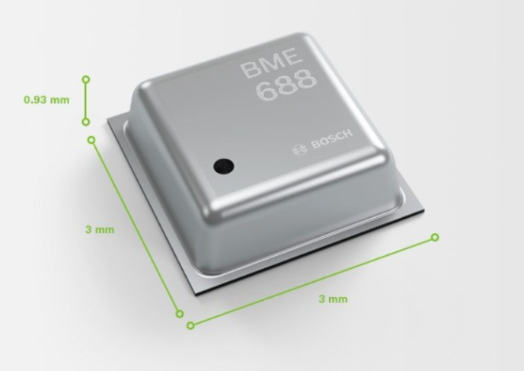
Temperature and Humidity Sensor
Selected Component: Bosch BME688
Measures temperature, humidity, pressure, and gas resistance
3.0 x 3.0 x 0.93 mm³
 | Bosch BME680 | Bosch BME688
Unit Cost (USD) | 15.18 | 16.17
Interface | SPI and I2C | SPI and I2C
MOX Gas Sensing | No | Yes
Controlled odor-analysis | No | Yes
Notes:
For measuring temperature and humidity we chose the Bosch BME688 sensor. There were two main sensors considered for this function. The other was the BME680. The internal designs for these sensors as well as the price are very similar to each other. With both capable of using an SPI and I2C communication interface. The main difference that led the team to choosing the BME688 was a built in feature for Metal Oxide sensing (MOX). This feature allows us to program and calibrate the sensor to measure other types of gases, giving the design more flexibility in the case where another gas wanted to be measured.

Slide 21
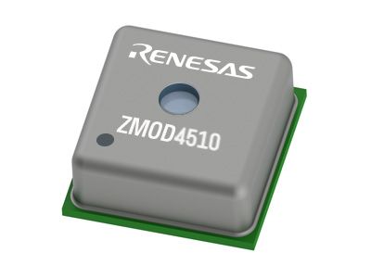
O3 and NO2 Sensor
Selected Component: Renesas ZMOD4510
Measures O3 selectively and NO2 non-selectively
3.0mm x 3.0mm x 0.7mm
 | Spec DGS-O3 | Renesas ZMOD4510
Unit Cost (USD) | 150.00 | 7.50
Interface | UART | I2C
Package | Daughter board | SMD
Assembly | 6-pin 15x15 1000 ppm Package 110-102 | 12-pin LGA
Notes:
To measure O3 and NO2, two types of sensors were considered. The first was the SPEC DGS-O3 sensor part of the Spec family of gas sensors. The second sensor which was the one chosen for this design was the Renesas ZMOD4510. The differences between these 2 sensors were significant in both price and design as can be seen in the table. The spec sensor came on a daughterboard with other components already soldered on it and uses UART communication. Although it would have decreased the amount of effort required to solder components to the board as well as programming the firmware, it wouldve drastically increased cost and we wouldve had to cconvert the communication interface to the board. Additionally, the renesas ZMOD sensor has a selective O3 measurnemnt that can be turned off to activate a low power mode

Slide 22
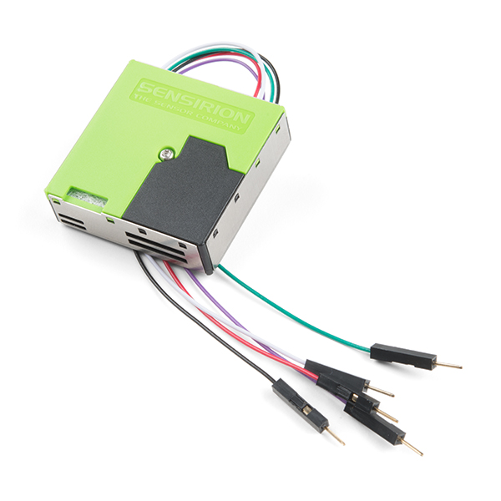
Particulate Matter Sensor
Selected Component: Sensirion SPS30
Measures concentration of particulate matter in sizes PM1.0, PM2.5, and PM10.
 | SEN54-SDN-T | Sensirion SPS30
Unit Cost (USD) | 34.99 | 50.00
Supply Voltage (V) | 5 | 5
Connector | 6 pin layout | 5 pin layout
Availability | Unavailable in 2021 | In stock
Outputs PM2.5? | yes | yes
Outputs PM10? | yes | yes
Notes:
The sensor chosen for measuring Particulate matter was the SPS30 sensor. It takes in ambient particles through a built in fan and operates on the principle of laser scattering to detect particulate matters of varying diameters. The SEN54 sensor was also consider however We were unable to purchase the SEN54, due to it just releasing around the time we were considering.

Slide 23
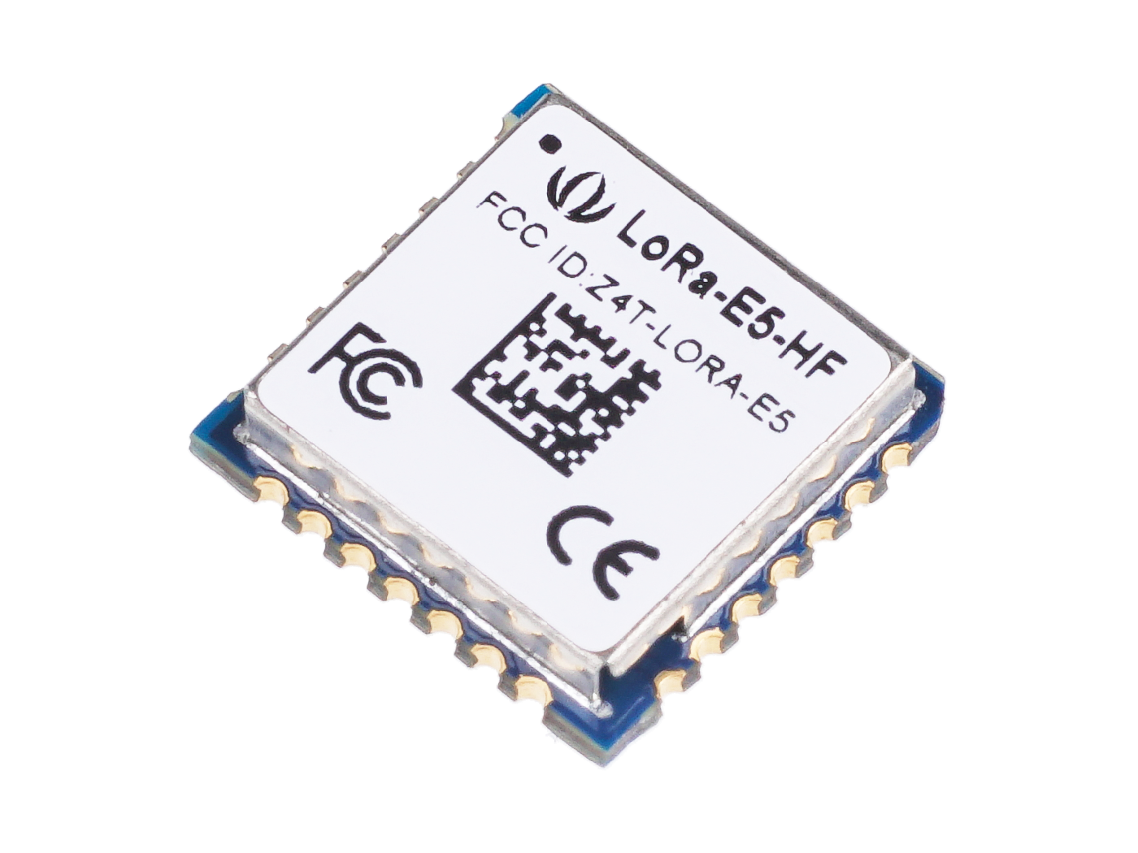
Microcontroller
Selected Component: Seeed LoRa-E5
Wanted an integrated LoRa module + MCU
Wanted low sleep and transmit power
 | Midatronics Windy | Microchip WLR089U0 | RAK 4600 | Onethinx Core | Seeed LoRa-E5
Processor Core | ARM Cortex-M4 | ARM Cortex-M0+ | ARM Cortex-M4 | Cortex M0+ | ARM Cortex-M4
Unit Cost (USD) | 20.00 | 15.00 | 10.00 | 20.00 | 8.00
Dev Board Cost (USD) | 65.00 | 114.00 | 35.00 | 80.00 | 18.00
Transmit Current (mA) | 120 | 115 | 125 | 118 | 107
Sleep Current (µA) | 0.360 | 1.61 | 11.2 | 1.66 | 0.360
LoRa Antenna | U.FL | U.FL | U.FL | PCB Trace | External
Num. I2Cs | 1 | 4 | 1 | 1 | 1
Num. GPIOs | 23 | 27 | 10 | 8 | 10

Slide 24
MCU and Sensor Subsystem Schematic
Notes:
This is the MCU and Sensor Subsystem schematic. On the top left we have the BME688 sensor measuring temperature and humidity. The ZMOD sensor measuring O3 and NO2 is shown on the bottom left and the SPS30 PM sensor is shown in the middle. Each sensor’s SCL and SDA pins are connected to the respective pins on the MCU. The programming header can be seen in the top middle of the schematic and is interfaced with the MCU.

Slide 25
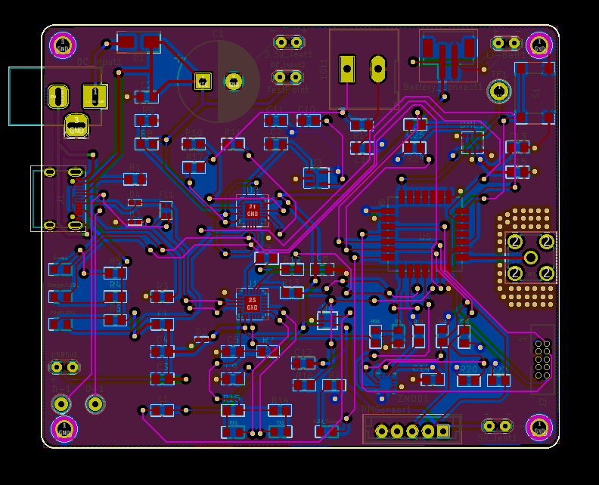
PCB Routing Layout
A 4 Layer PCB was used:
Top and Bottom Layer were used for signals
The 2nd layer was used as a 3.3V plane and to route other power signals
The 3rd layer was used as a ground plane
Dimensions: 82.5mm x 68mm

Slide 26
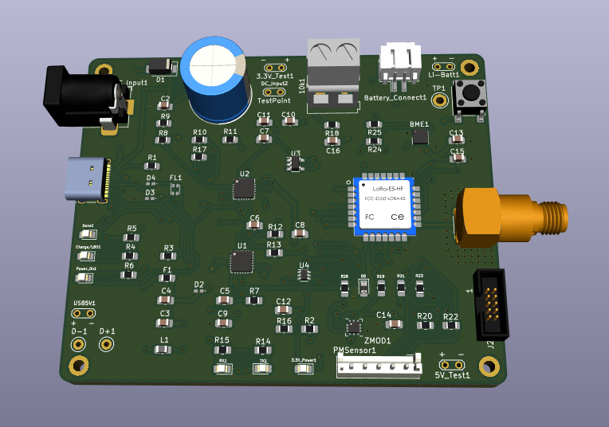
PCB 3D Model

Slide 27
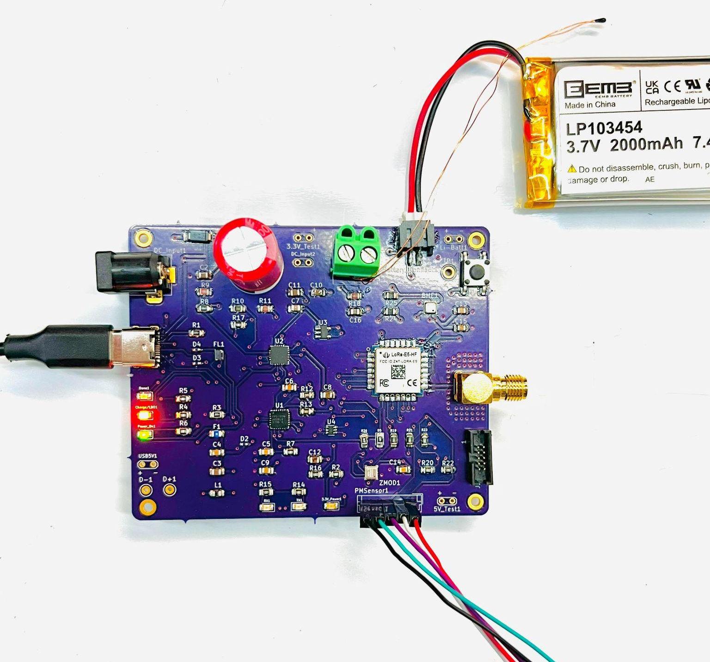
PCB Photo

Slide 28
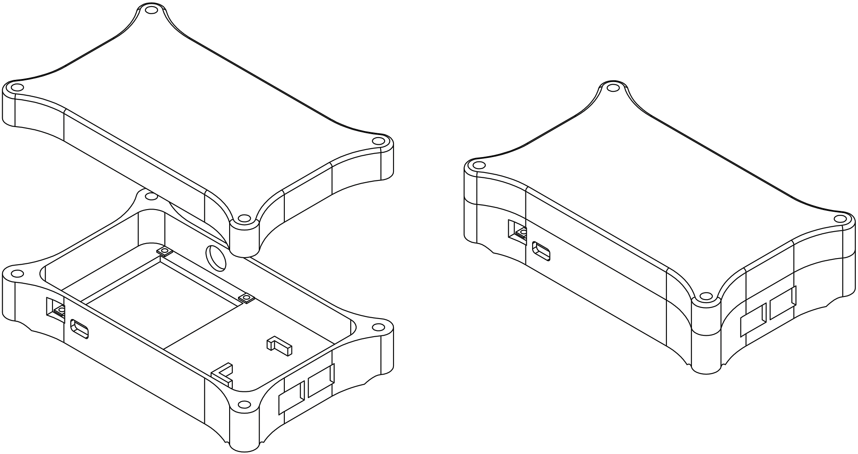
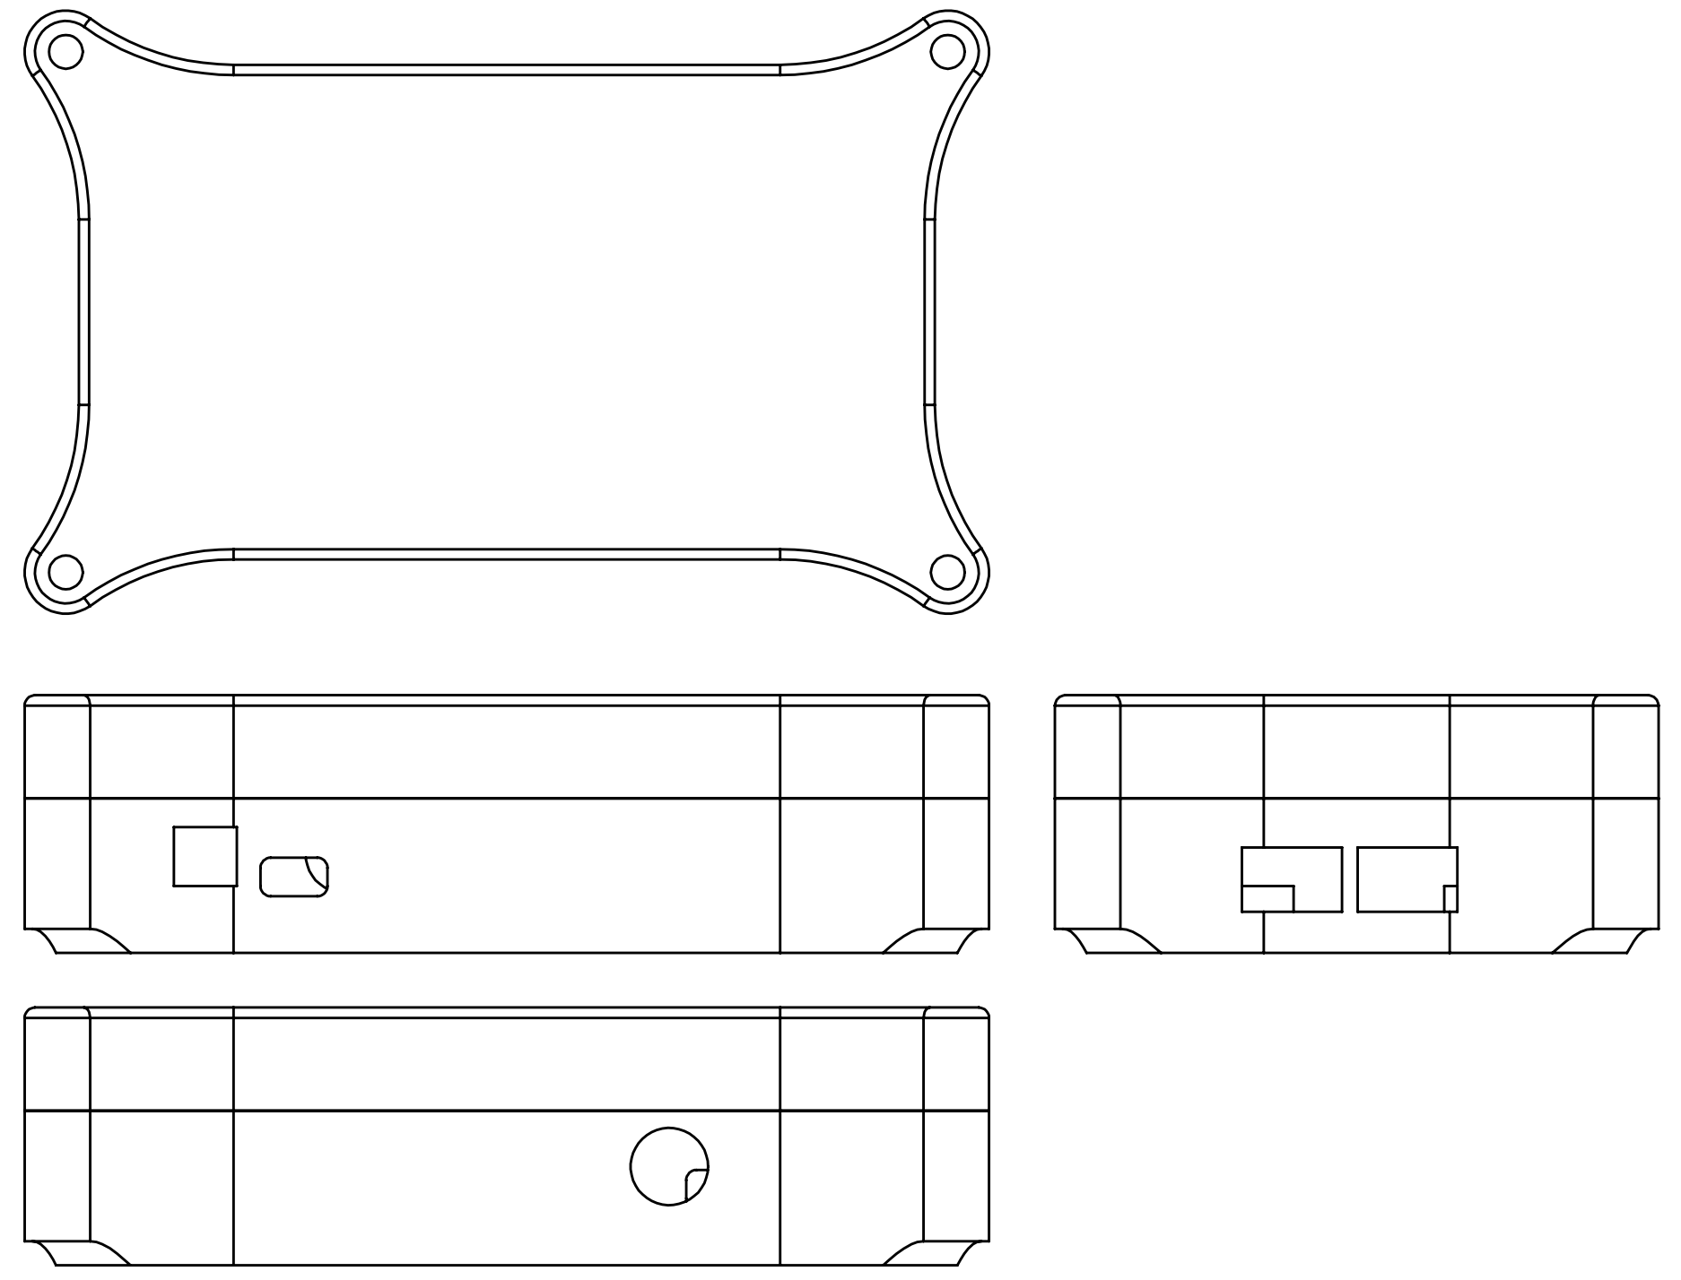
Enclosure Design
Isometric View
Projected View

Slide 29
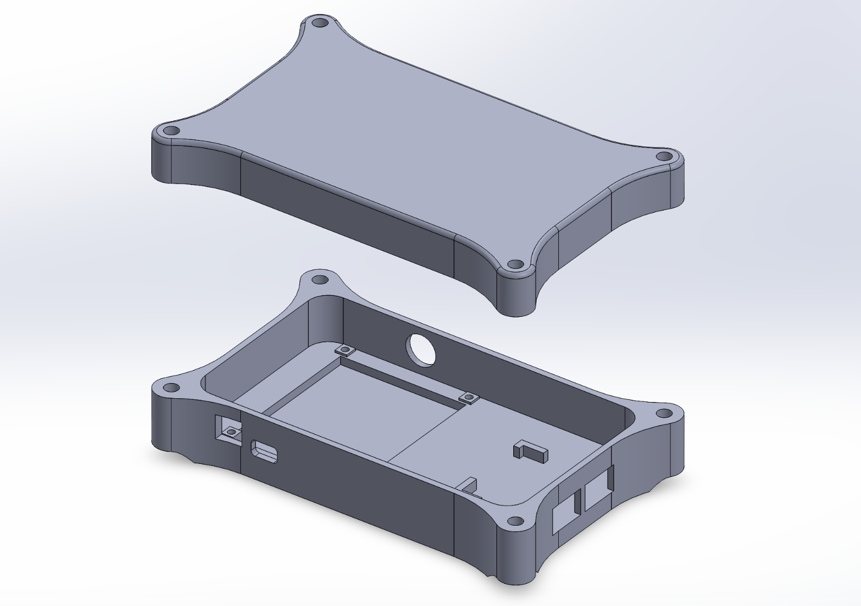
Enclosure Design

Slide 30
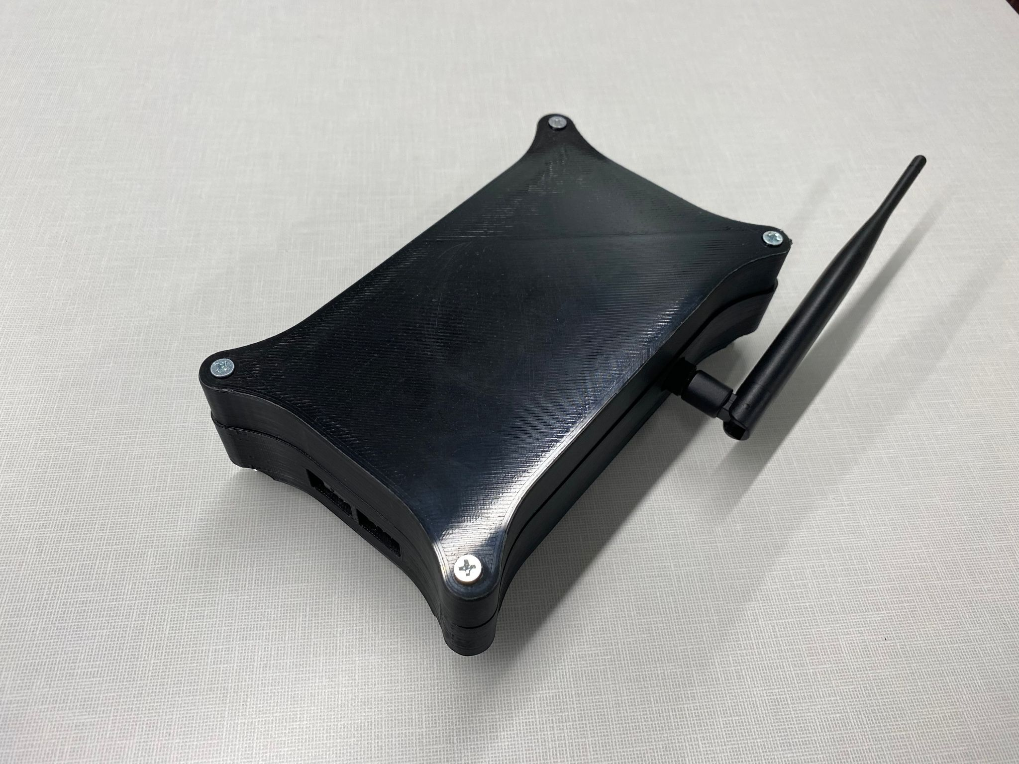
Final Prototype

Slide 31
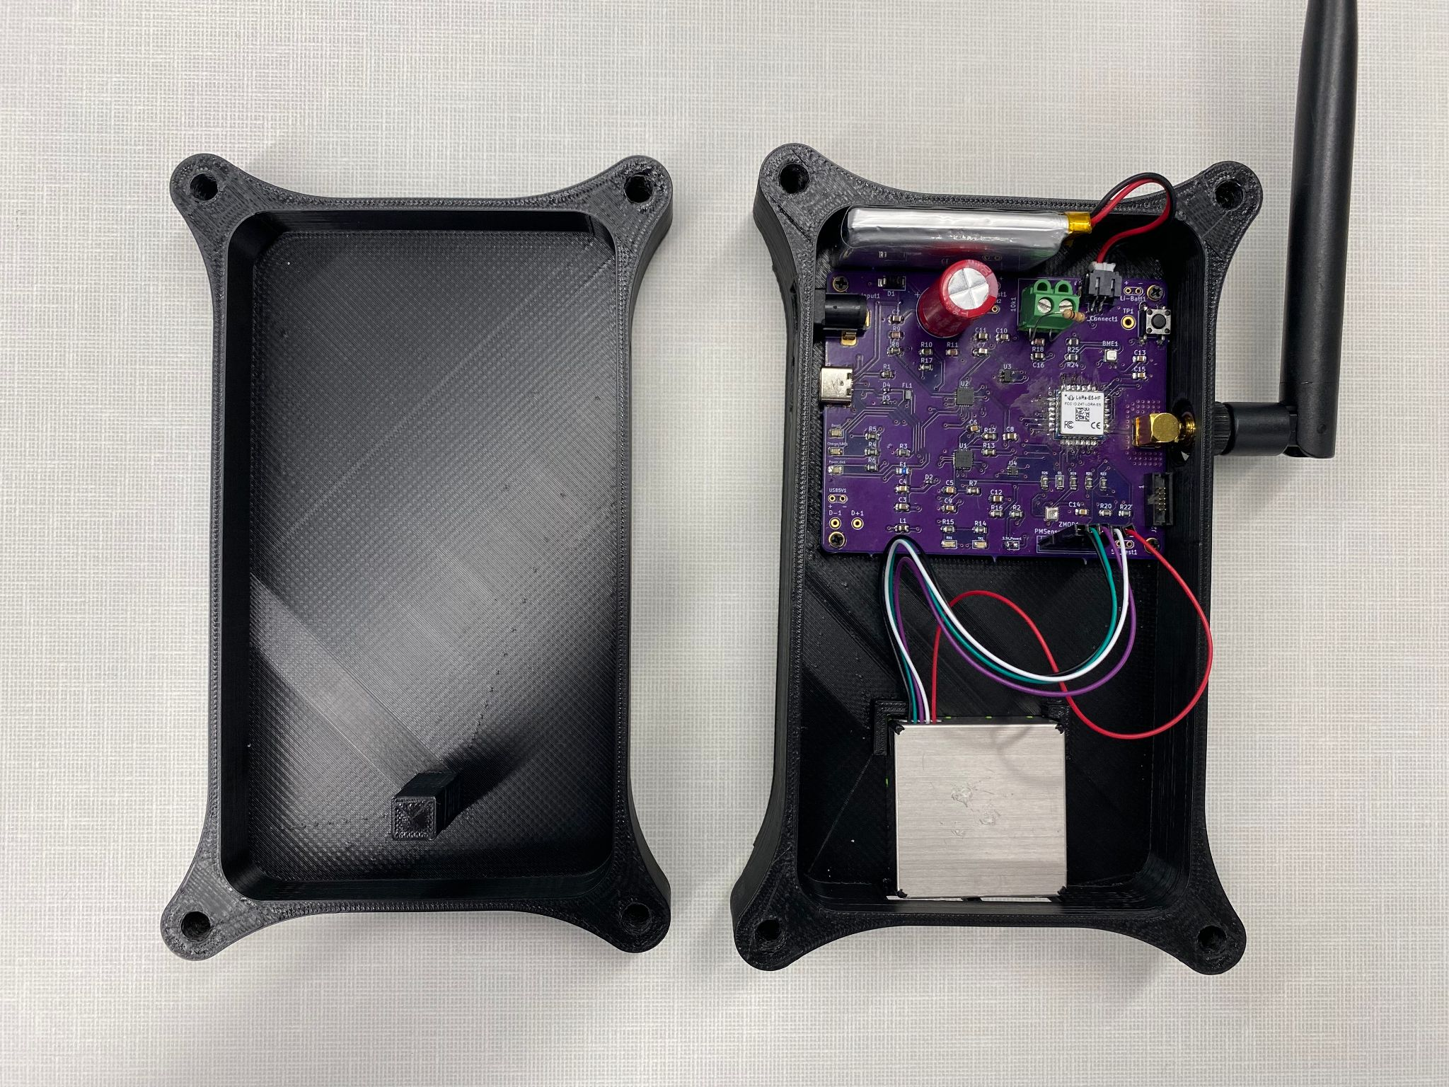
Final Prototype

Slide 32
Firmware

Slide 33
Firmware Design Requirements
Read data from the sensors
Transmit data over LoRaWAN
Manage the system power
Allow the user to manually read sensors from a shell
Notes:
Ian

Slide 34
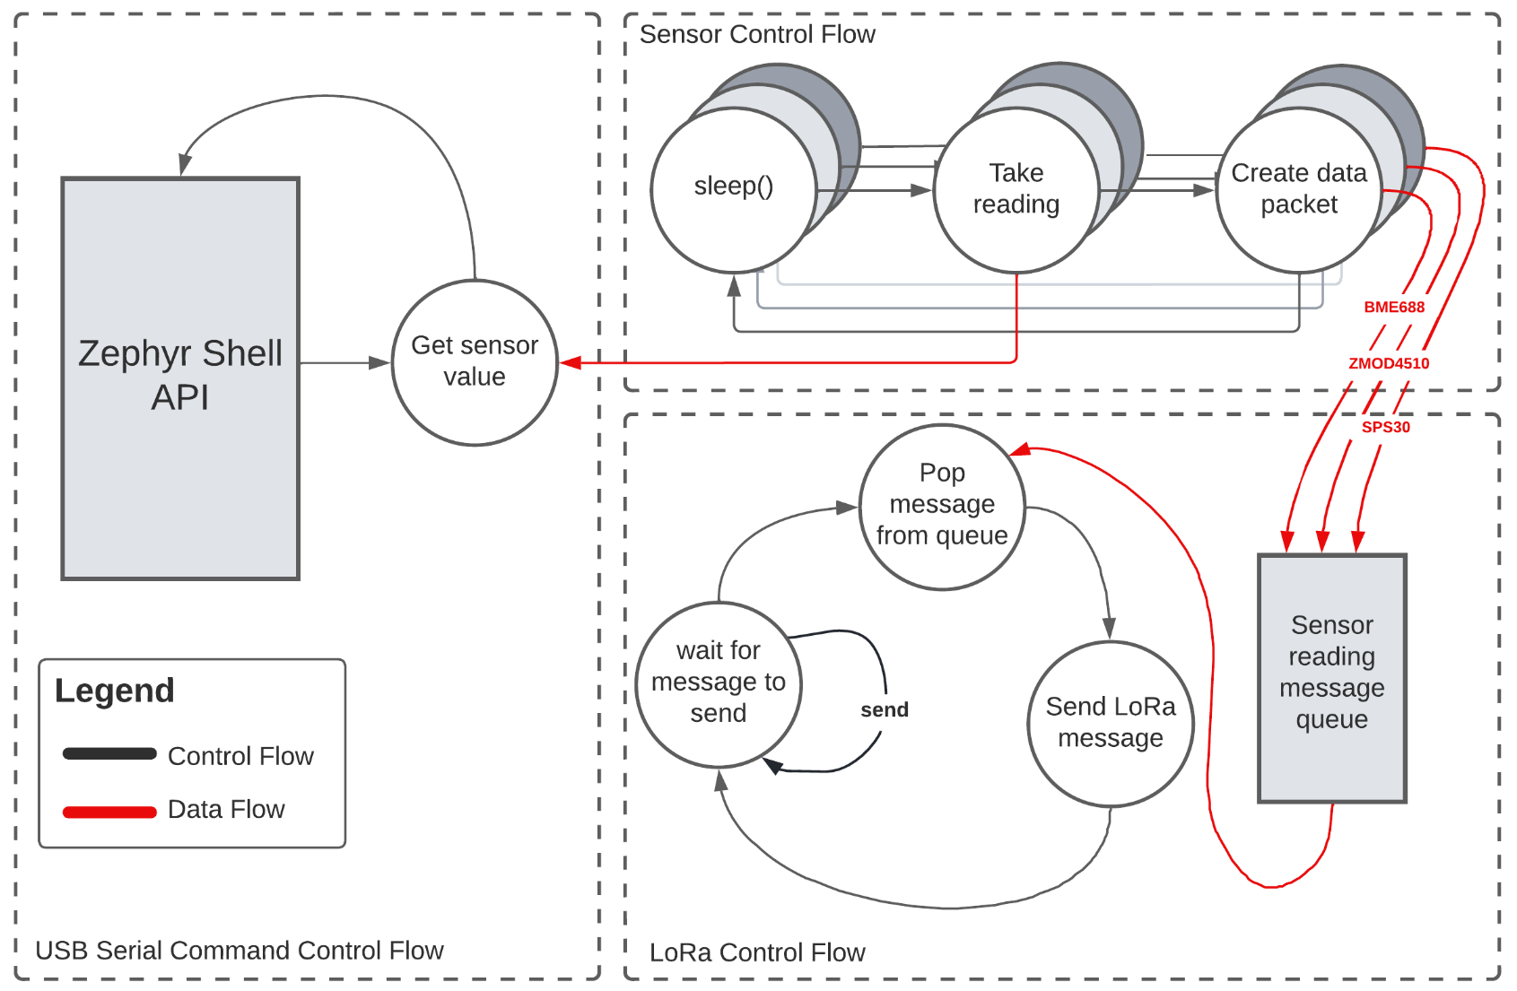
Firmware Block Diagram

Slide 35

Real Time Operating System
Selected Component: Zephyr RTOS
We preferred working in a command line environment over an IDE
FreeRTOS is bare bones
 | FreeRTOS + STM32Cube IDE | Zephyr RTOS
Dev Environment | IDE | CLI + Text Editor
Driver Model | HAL | Device Tree
User Shell | External code available | Built-in
Power Management | External code available | Built-in
LoRaWAN Drivers | Built-in | Built-in
Empty Project Size (kB) | 6.3 | 13.1

Slide 36
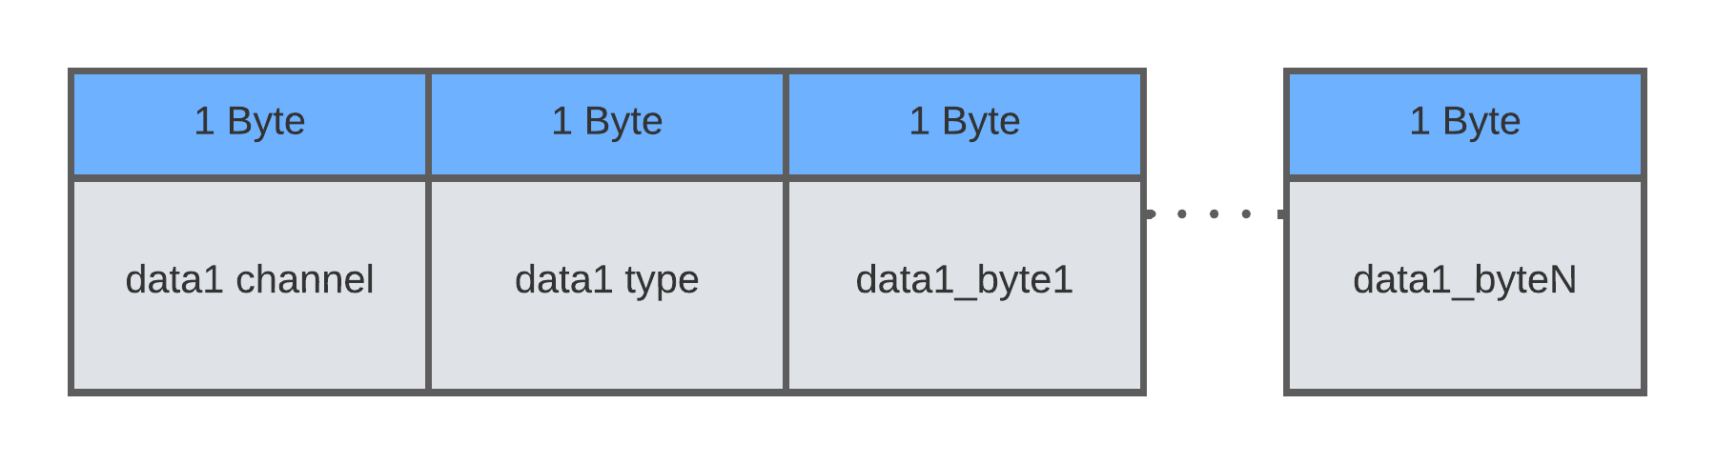
Firmware Design - Data Packet
Sensor readings are packaged and sent over LoRaWAN using the CayenneLPP format
Contains the following:
Channel (e.g. BME688)
Type (e.g. temperature)
Data bytes (the payload)

Slide 37
Firmware Design - Power Management
SPS30 is turned off when not in use
MCU enters sleep state (stop1) when no measurements are being performed
Unable to access lowest, low-power mode through Zephyr
Needed to use the low-level HAL drivers

Slide 38
Web Application & Backend

Slide 39
Web Application Requirements
Display data on a map overlay
Anyone can view the sensor data
Device specific info is private
Send email alerts based on sensor readings
Notes:
Paul
Basics:
Display sensor data
Select sensor data to display
Interactive map
Click to get tooltip about device, specific readings
Easily request different data from the API as the progress evolves

Slide 40
Backend Requirements
Web server
Run code cheaply → serverless
Store and retrieve data
IoT-related services

Slide 41
LoRaWAN Architecture and Requirements
Join server
Network server
Application server
Physical gateway

Slide 42



Web Backend Services
 | Microsoft Azure | Amazon Web Services | Supabase
Cost | Free-tier, depends | Free-tier, depends | Free-tier, $25 / mo
Maturity | 14 years | 16 years | 2 years
Pricing Structure | Complex | Complex | Simple
Iteration Speed | Slower | Slower | Faster
Complexity | Very Complex | Very Complex | Simple
Services Integration | Extensive | Extensive | Limited
LoRaWAN Services? | No | Yes | No
Notes:
We were using AWS

Slide 43

The Things Stack
LoRaWAN backend
Manages devices/gateways
Service Integrations
AWS
Azure
Webhooks
…

Slide 44



Frontend Framework
 | Angular | Vue | React
Libraries | Moderate | Less | Vast
Popularity (stars) | 80.8k | 29.3k | 187k
Support | Less | Lesser | Most
Maturity | 12 years | 8 years | 9 years
Virtual DOM? | No | No | Yes
HTML-JS Interaction | Templates | JSX + templates | JSX

Slide 45
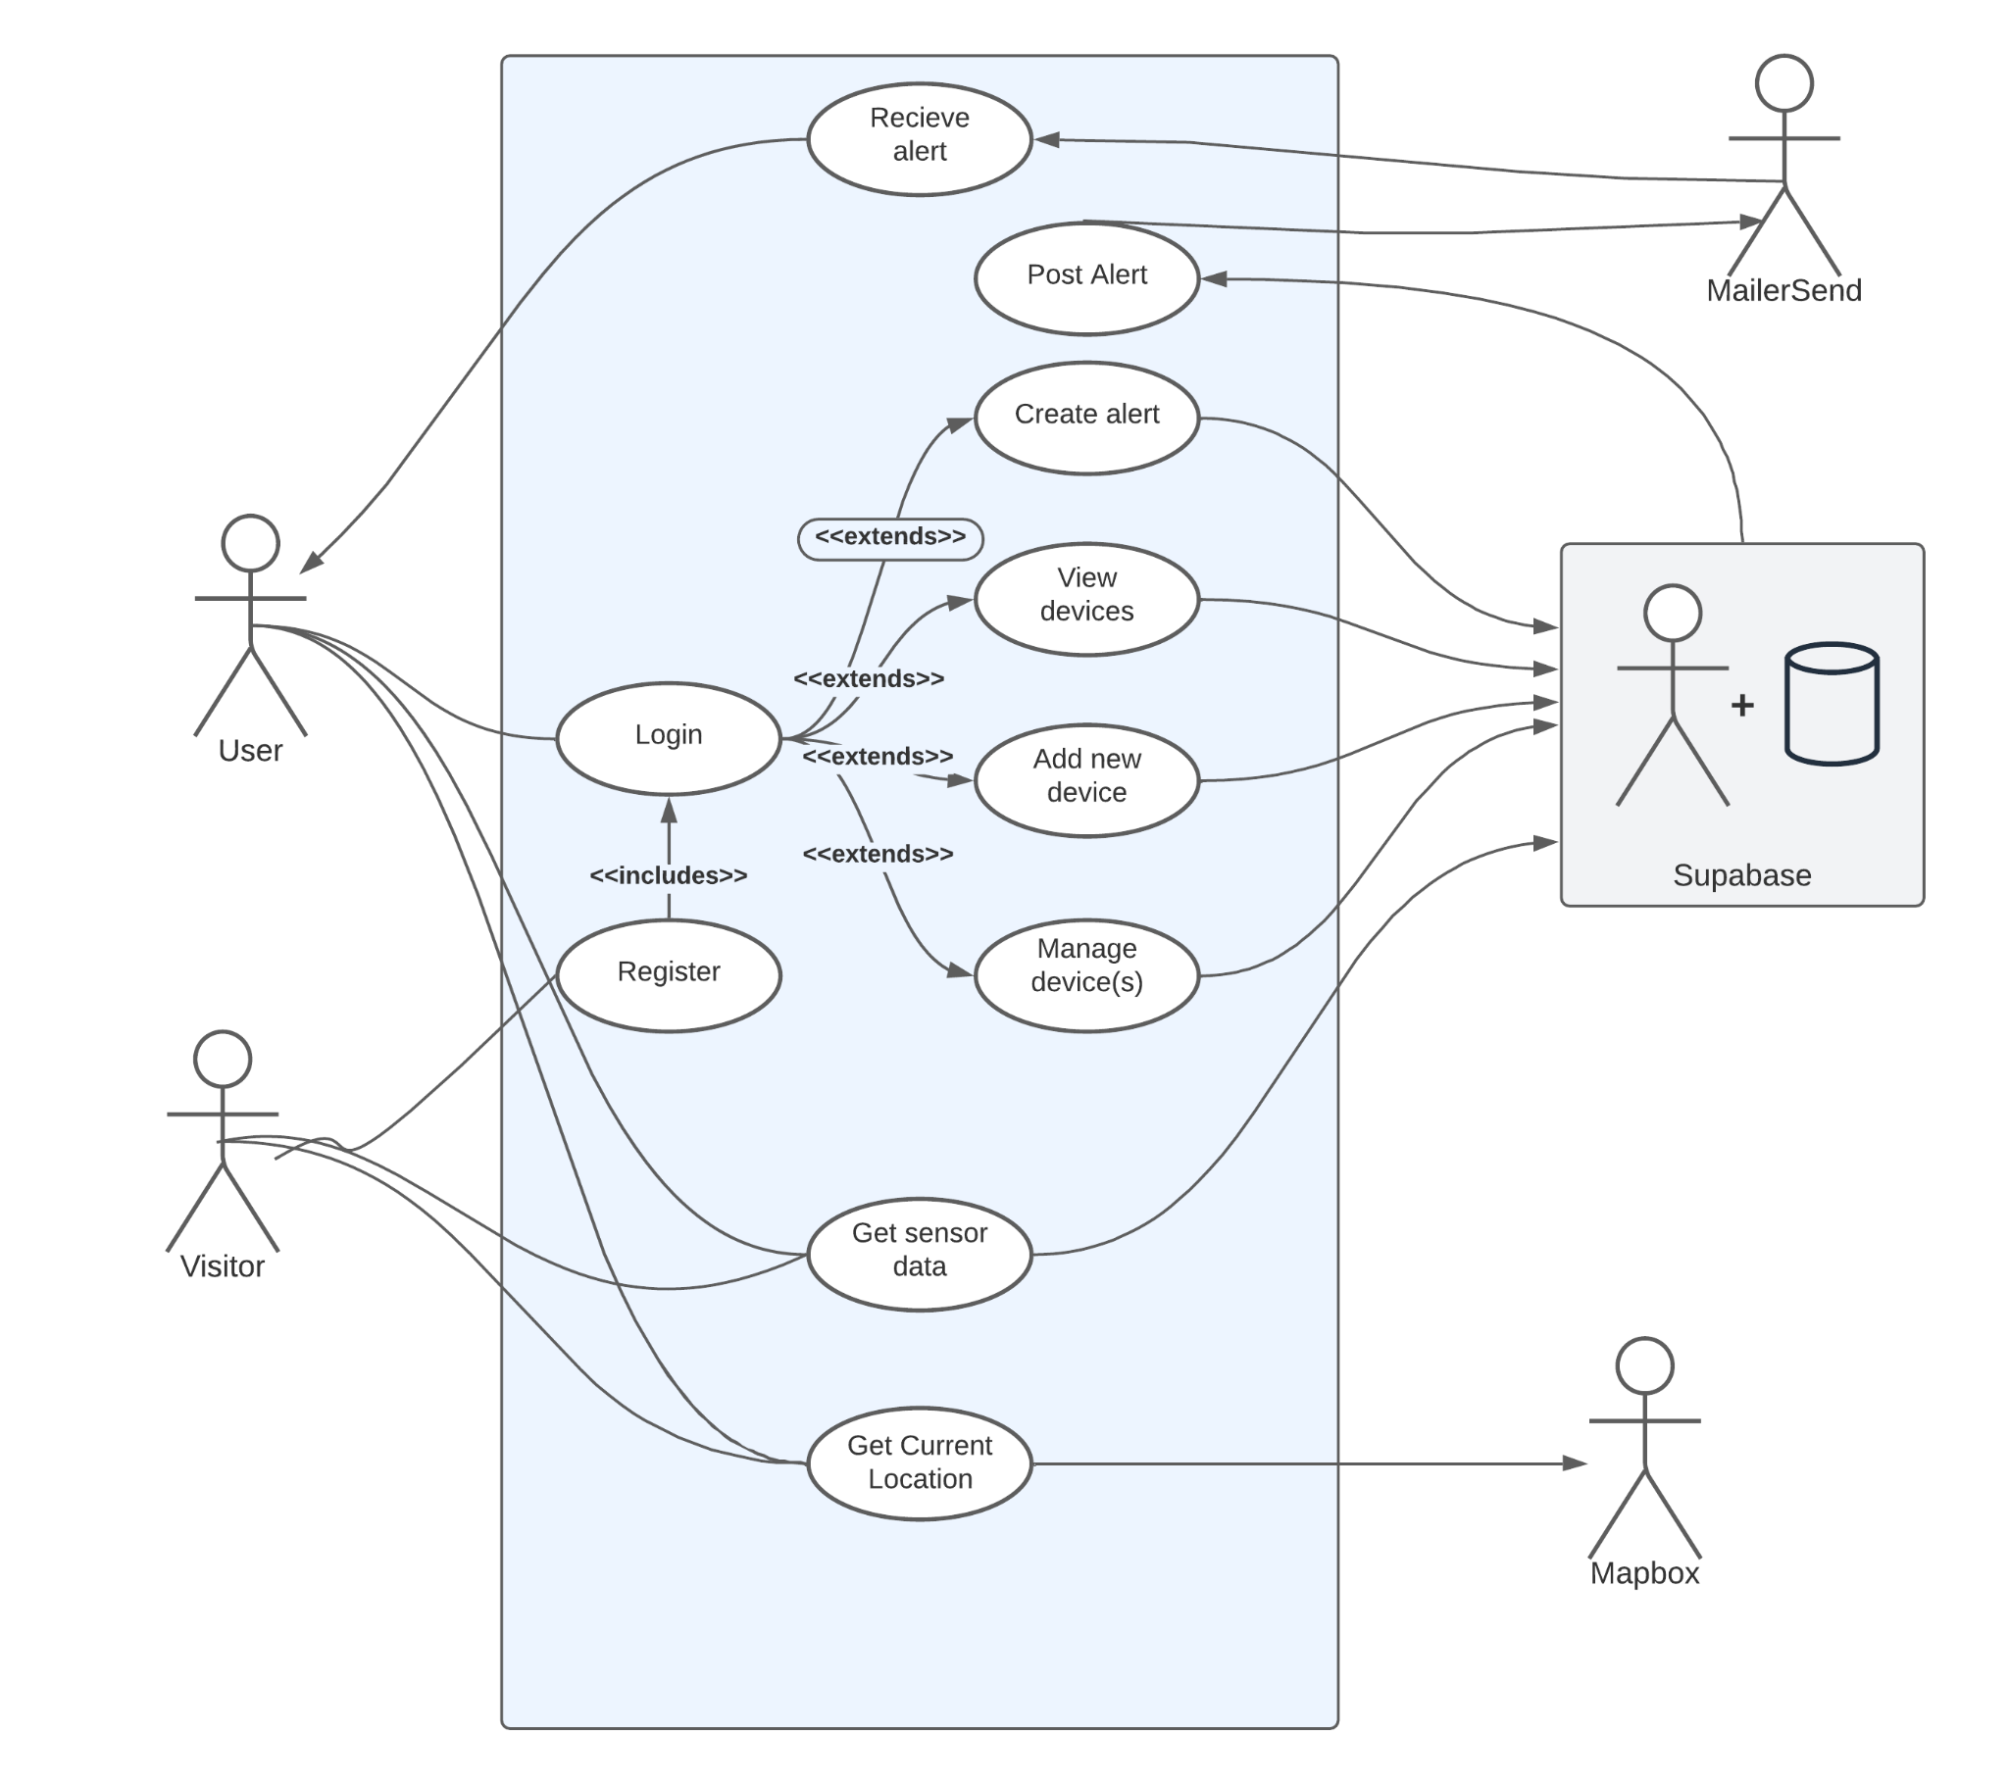
Use Case Diagram

Slide 46
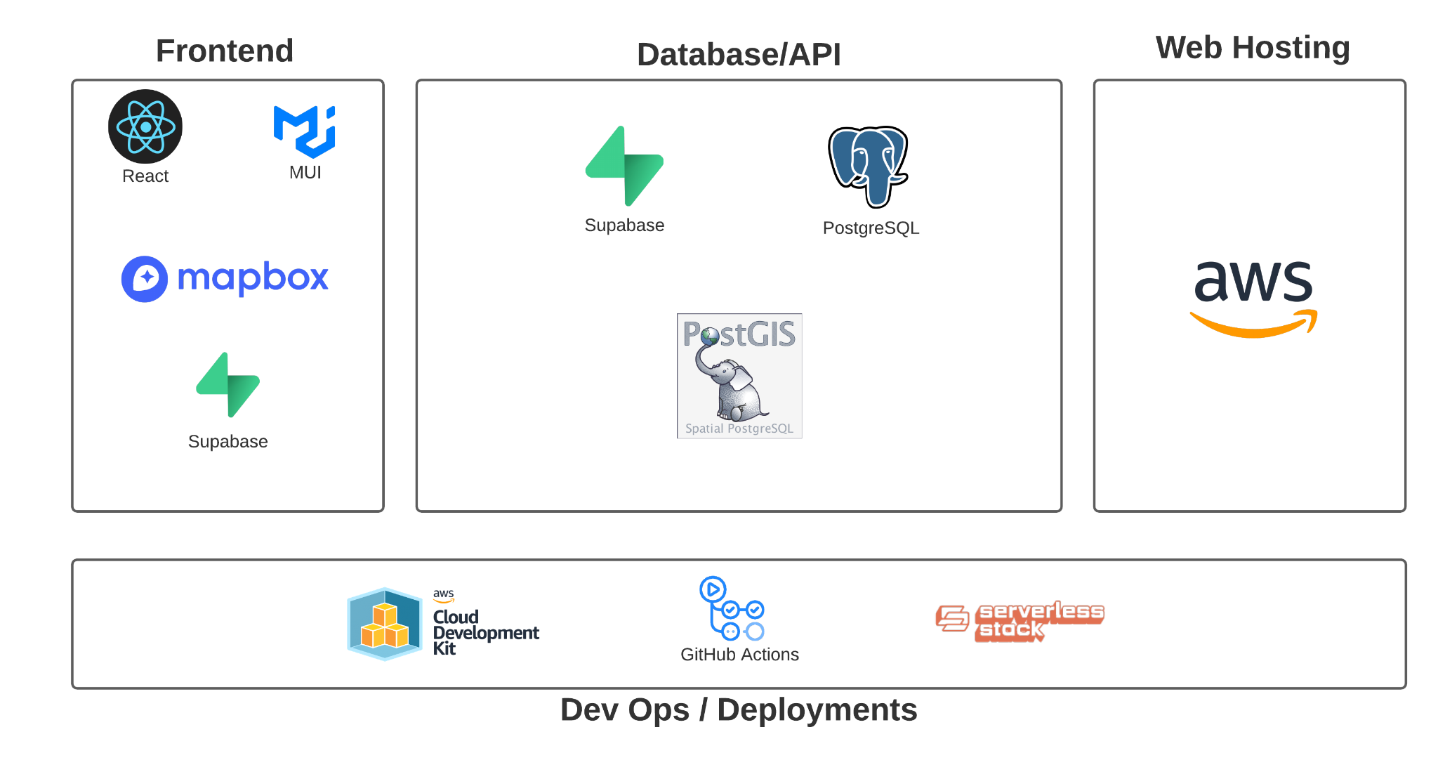
Stack Design

Slide 47
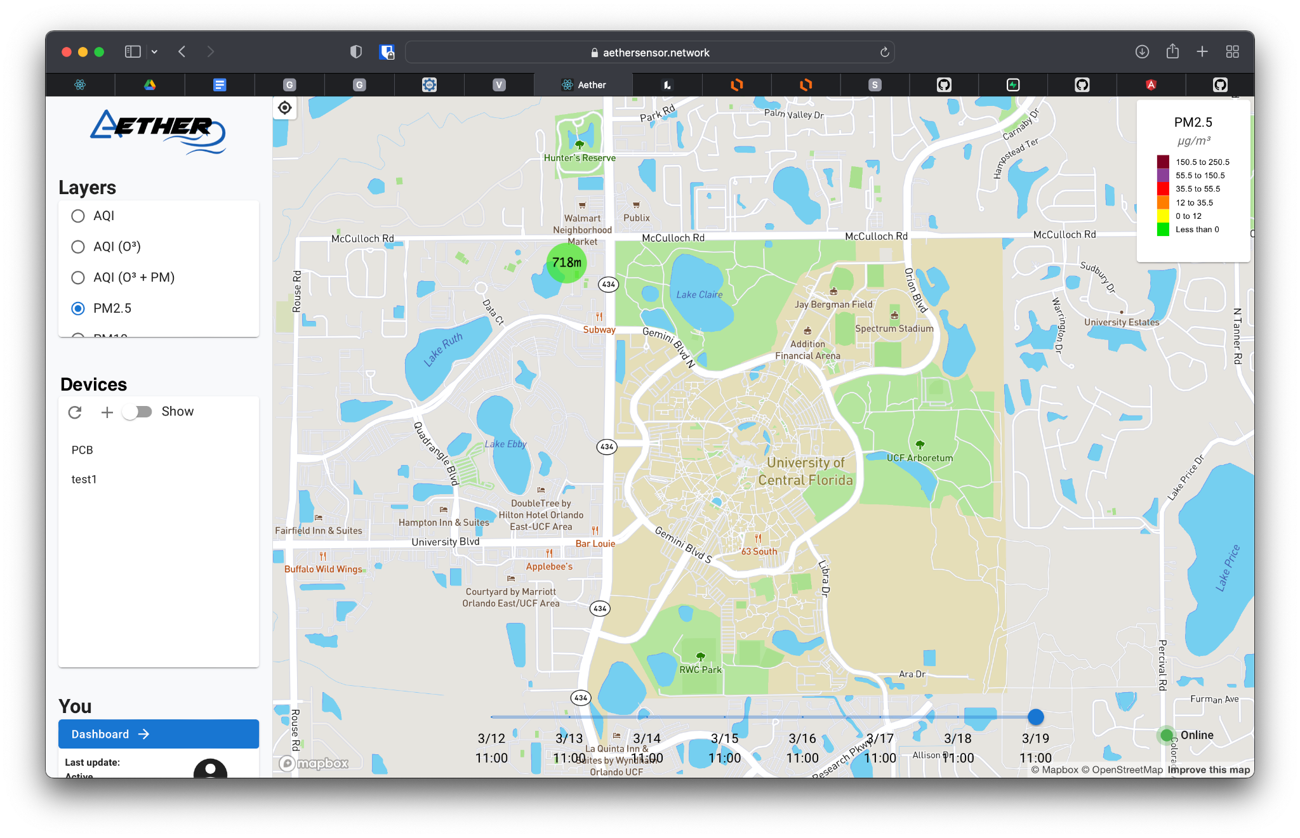
Web Application UI - Main Page

Slide 48
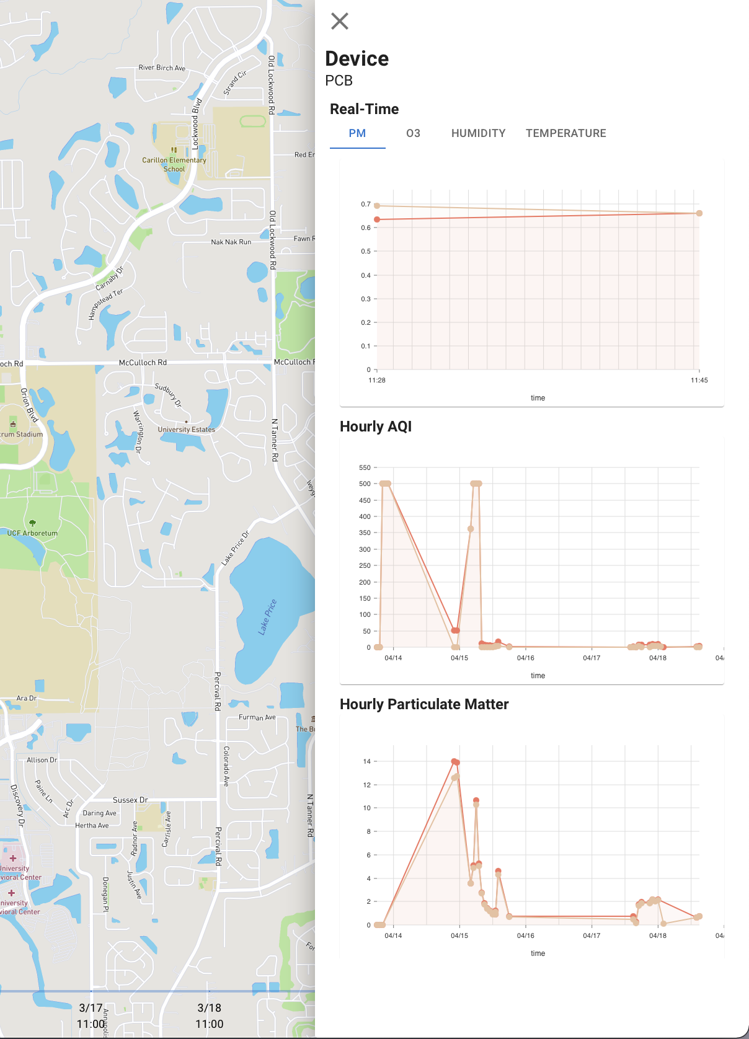
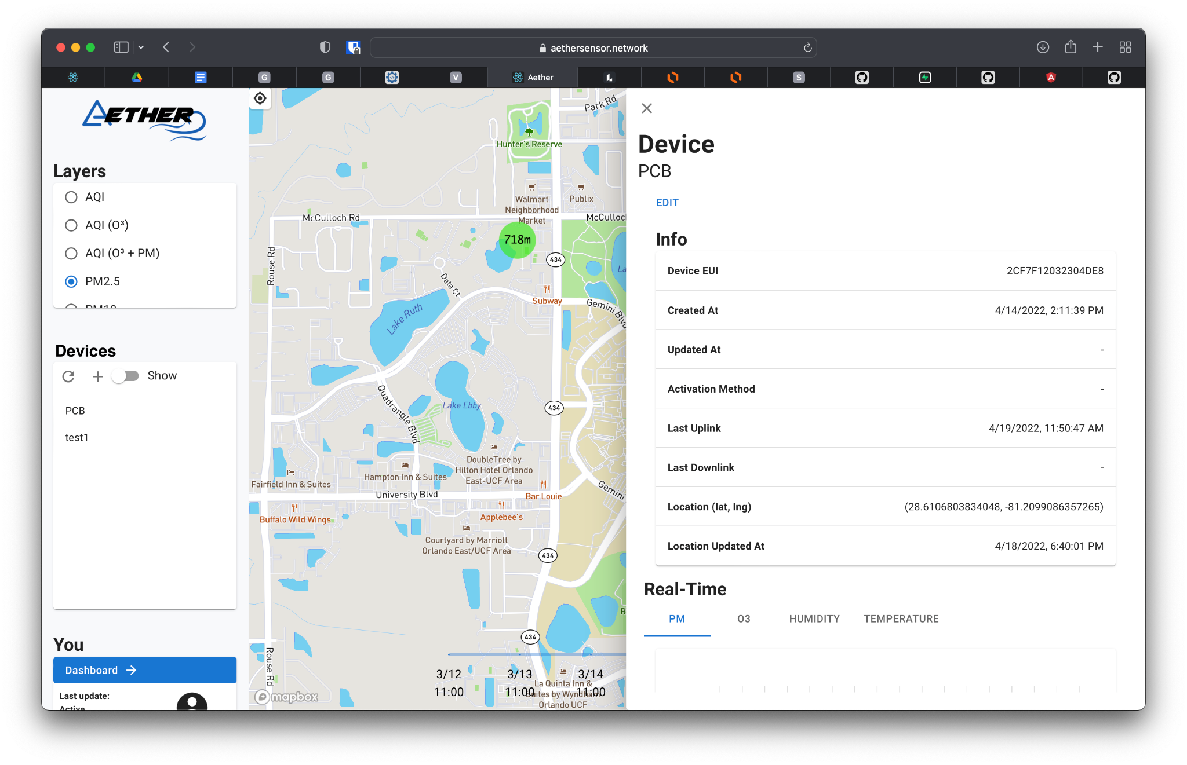
Web Application UI - Device View

Slide 49
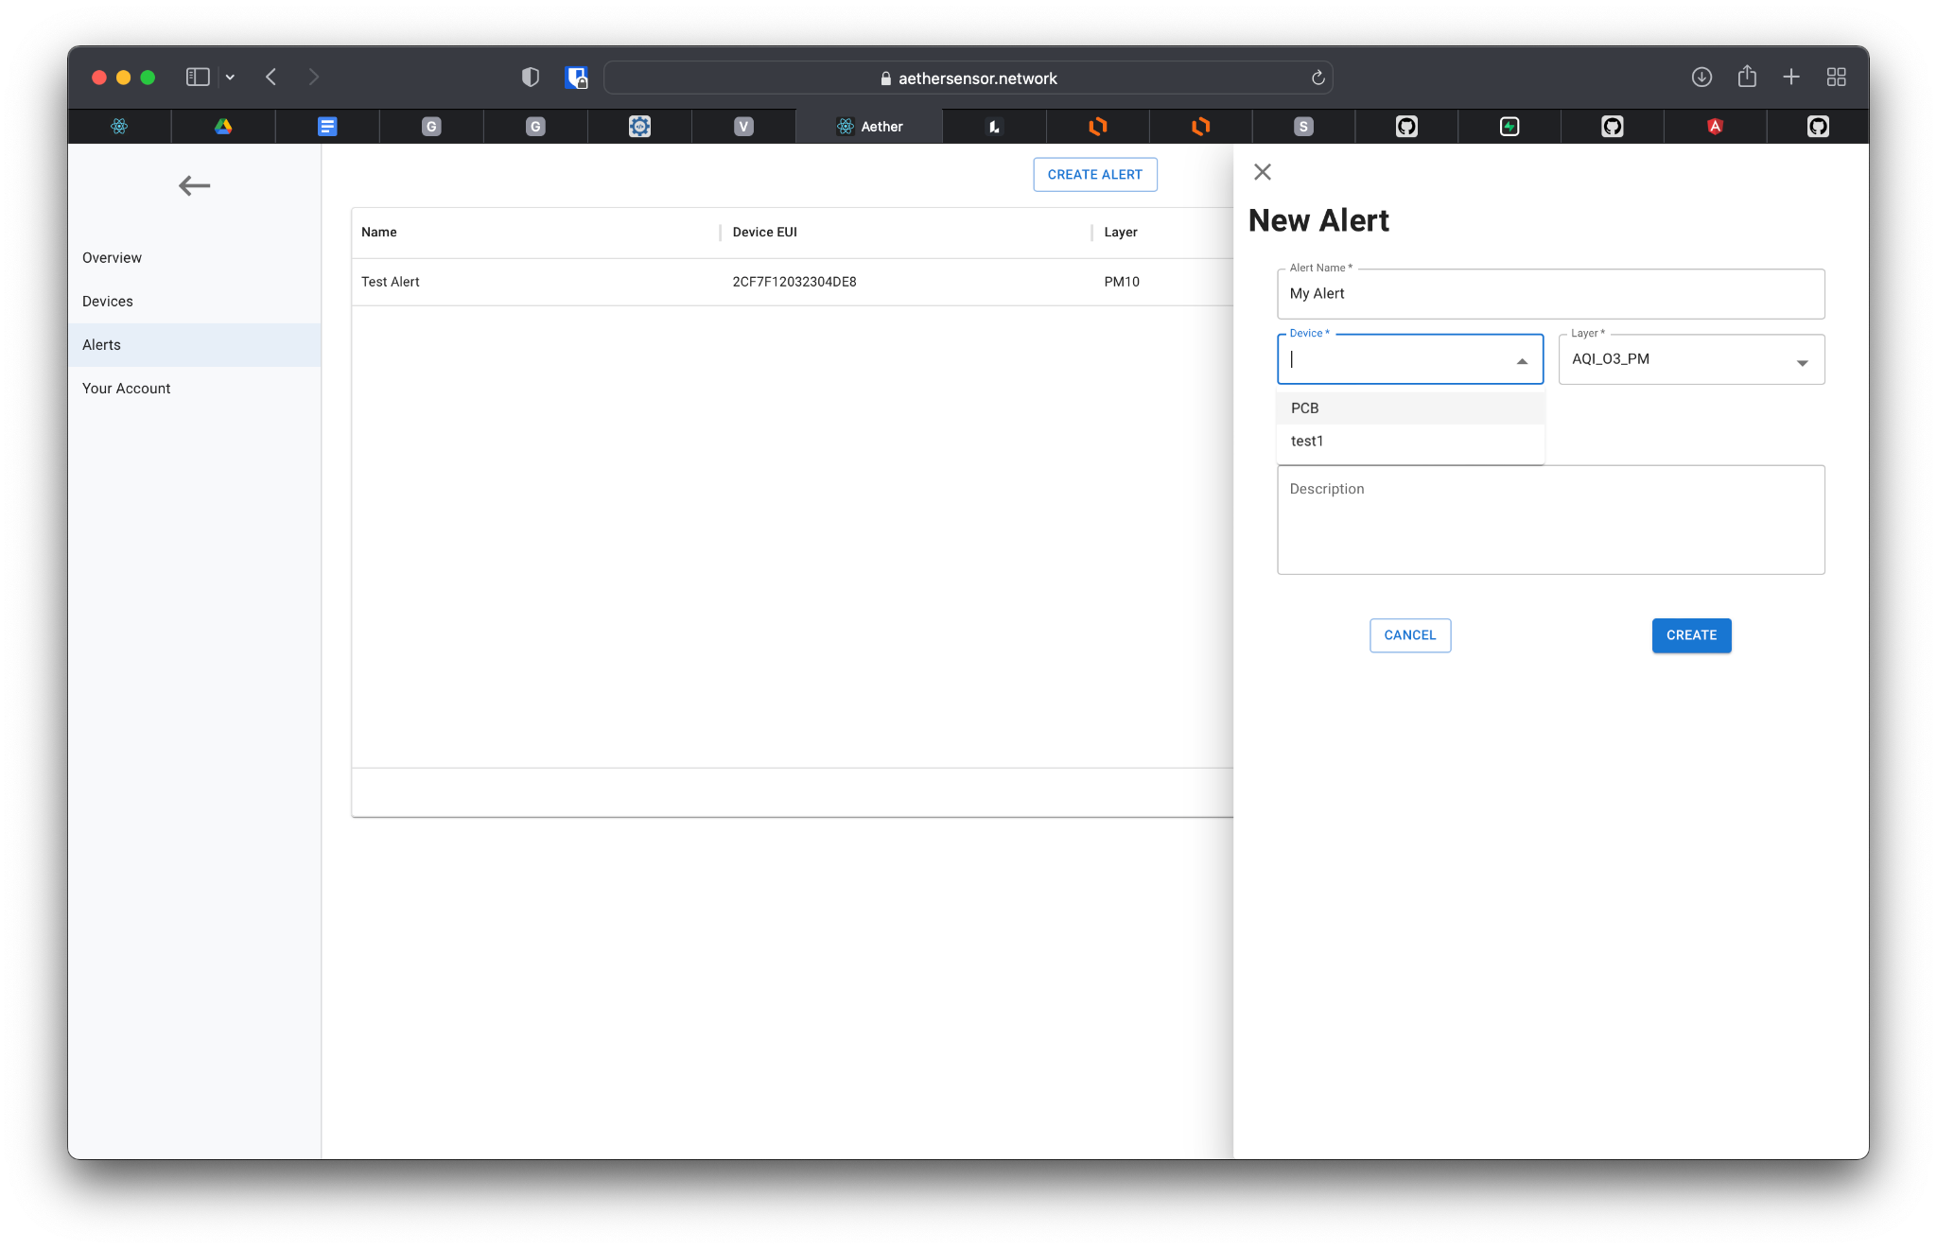
Web Application UI - Alerts

Slide 50
Challenges

Slide 51
Hardware Challenges
Challenge | Solution
Initially the charger would not charge the battery | Charger IC was not compatible with a 3-Cell Li-Io battery, a single-cell battery needed to be used
Power rail in PCB got shorted some components were damaged | A new pcb was used and damaged components were replaced
3.3V LDO stopped working | Cold solder joints were found. Resoldering fixed the issue
Charger would not charge battery | Thermistor was faulty and was giving extremely high resistance values causing charger to stop charging. New resistor solved issue

Slide 52
Software Challenges
Challenge | Solution
Getting power management to work | This required studying the Zephyr API carefully and doing a lot of trial and error.
Having two people work on the firmware simultaneously | Learning how to use Git properly i.e. using branches and the rebasing of commits.
Learning 10+ AWS services to do something that wouldn’t originally seem complicated | Start with the MVP / migrate to Supabase
End-to-end testing | Manual fuzz testing

Slide 53
Administrative Content

Slide 54
Budget
Item | Cost($)
PCB | 26.45
PCB Components | 55.02
Sensors | 77.13
LoRa Module | 8.38
Enclosure | 3.04
Solar Panel | 35.00
Battery | 16.95
Total | 221.91

Slide 55
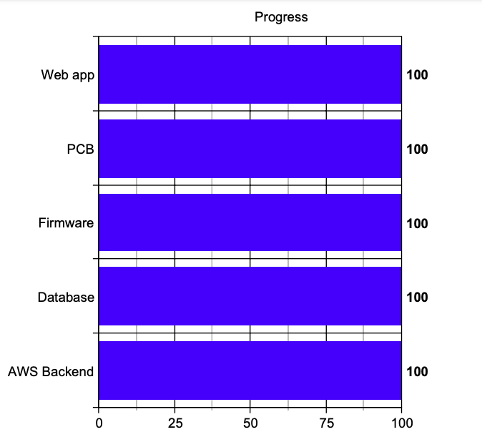
Project Progress

Slide 56
Work Distribution
 | Schematic | PCB | Enclosure | Shell | Firmware | Backend | Web App
Parke | Primary | Secondary | Primary
Randy | Primary | Primary | Primary
Paul | Secondary |  |  |  | Secondary | Primary | Primary
Ian | Secondary |  | Secondary | Primary | Primary

Slide 57
Questions?

